Slide 1
Press X To Begin Your Presentation

Slide 2




Developers Guide: Create Your Next Hit Game On Steam
Presented by Eman Raeesi
➜

Slide 3
Table of contents
01
03
02
04
OVERVIEW
ANALYSIS
BUSINESS QUESTION
RECOMMENDATIONS

Slide 4

STEAM OVERVIEW
Steam's primary service is to allow its users to purchase games and other software.
key aspects of Steam
01
Game Library
Launched in Sep, 2003
Developed by
Valve Corp
02
Community Features
03
Sales and Discounts
Revenue Streams
Competitors:
Epic Games Store - EA App - Ubisoft Connect
Game Sales - In-Game Purchases - Game Releases
Notes:
Steam's primary service is to allow its users to purchase games and other software, adding them to a virtual library from which they may be downloaded and installed an unlimited number of times.

Slide 5

Business Question
What are the patterns followed by successful games?

Slide 6

GAME ANALYSIS

Slide 7
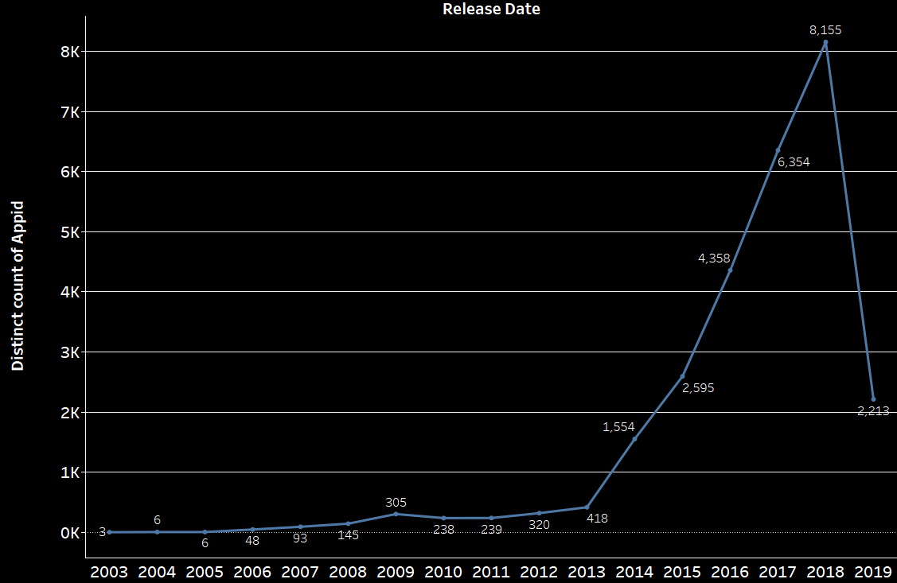
GAMES RELEASES OVER TIME
Average Games Released yearly in the past 5 years
790
Games
Notes:
There was a peak in 2018
Total number of games available are 27K
Could be accredit to Battle Royale Boom, a growing market, and a rise of digital distribution
The Average of game releases in the past 5 years is 790 games

Slide 8
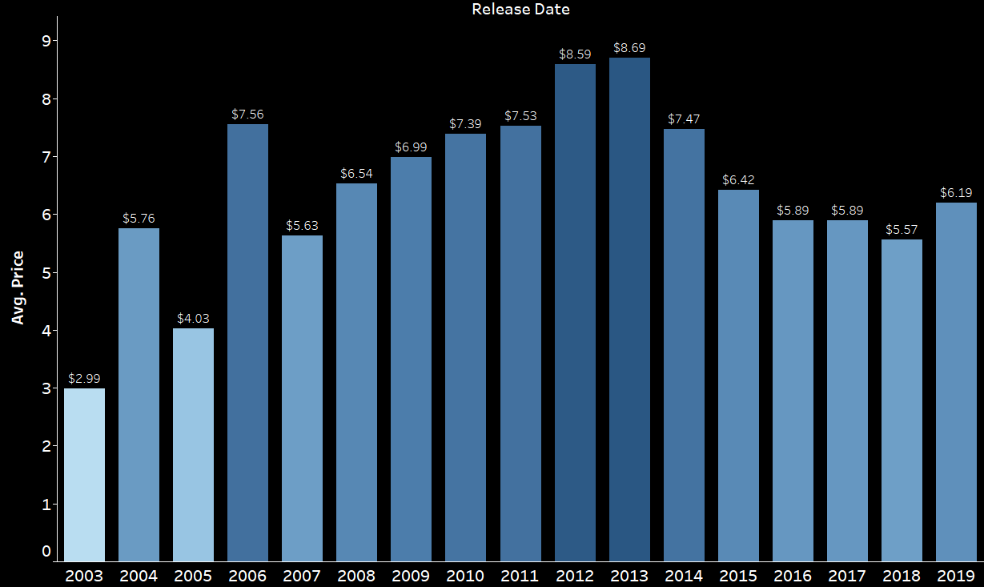
YEARLY AVERAGE GAME PRICE
The average price for games in the past 5 years is $5
Notes:
The highest average is found in 2013, while in 2018 during the peak of game releases the average price drops to $5.5
The average price for games in the past 5 years is $5

Slide 9
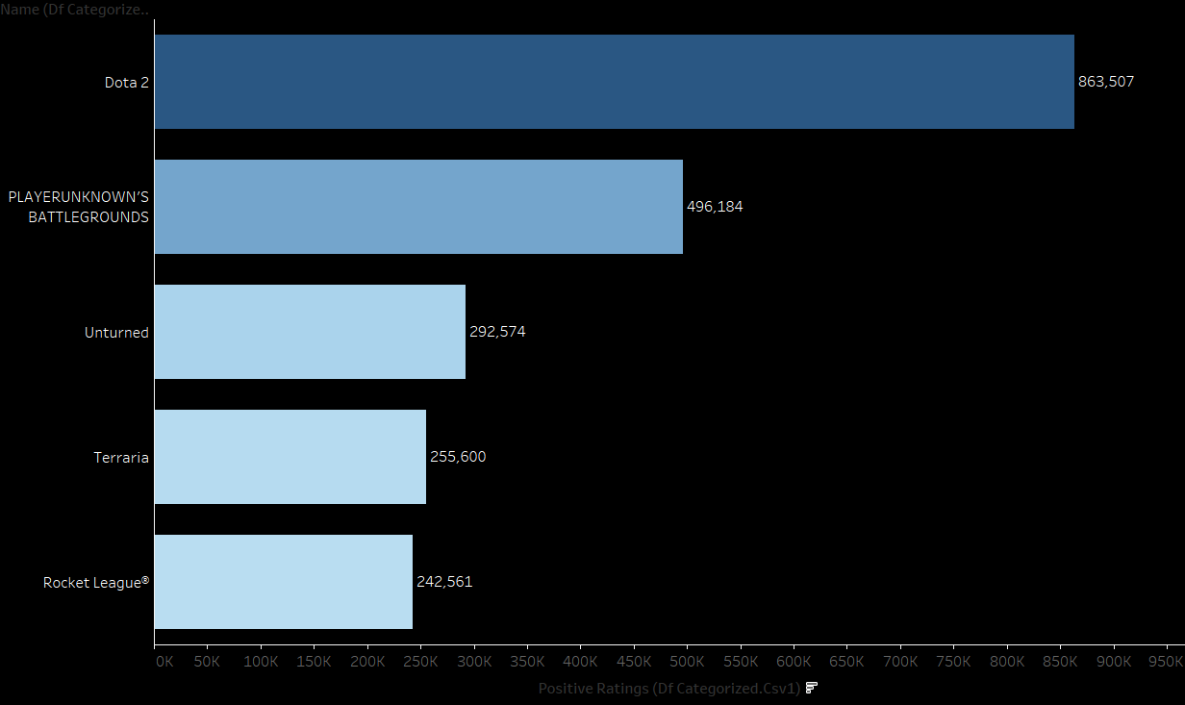
TOP RATED GAMES
Notes:
The average number of positive ratings is 1k per game

Slide 10
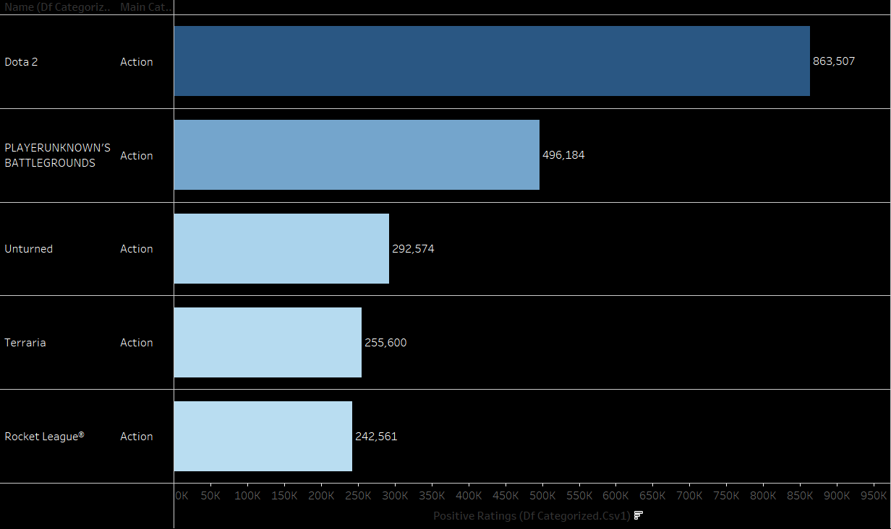

Slide 11
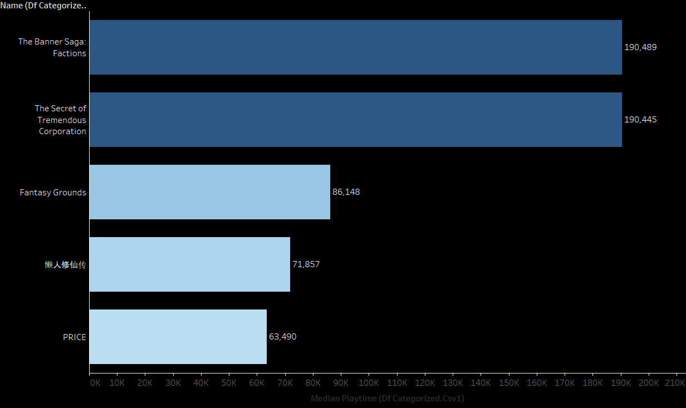
MOST PLAYED GAMES
Notes:
The Average playtime is 144 hours which converts to 6 days.

Slide 12
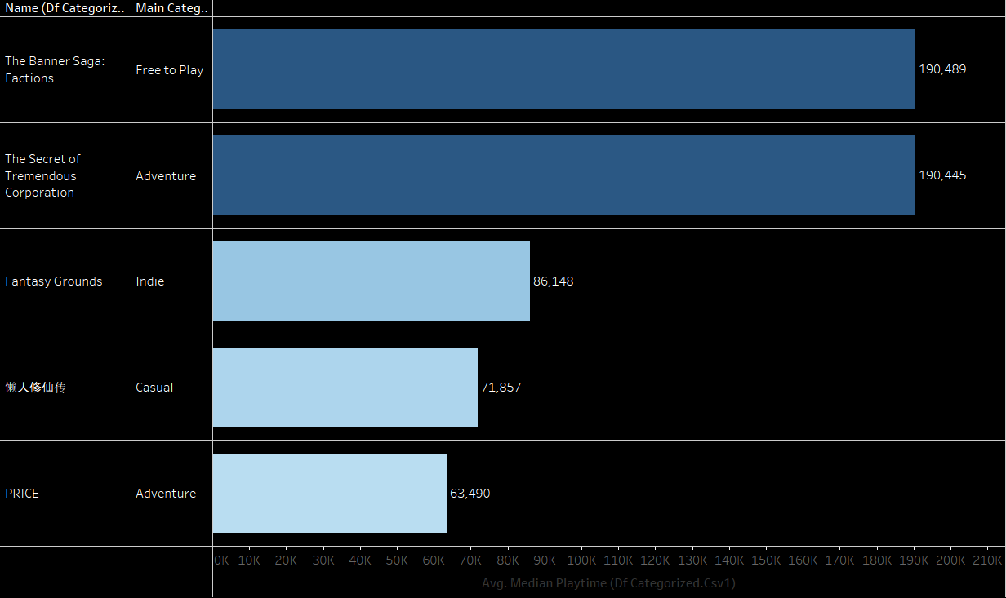
Notes:
The Average playtime is 144 hours which converts to 6 days.

Slide 13
GENRE ANALYSIS

Slide 14
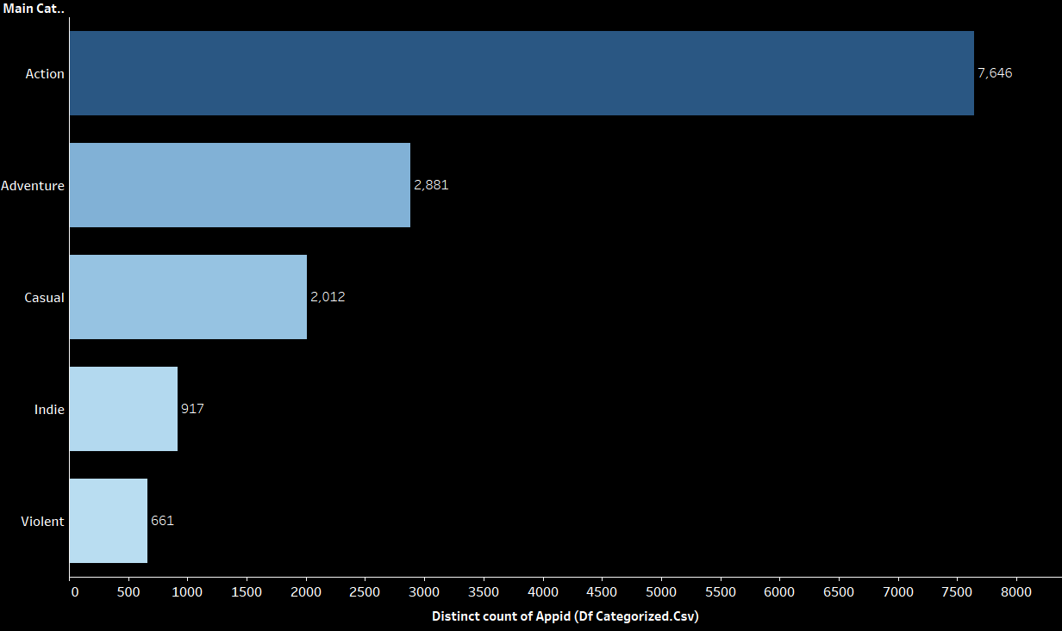
TOP RATED GENRES

Slide 15
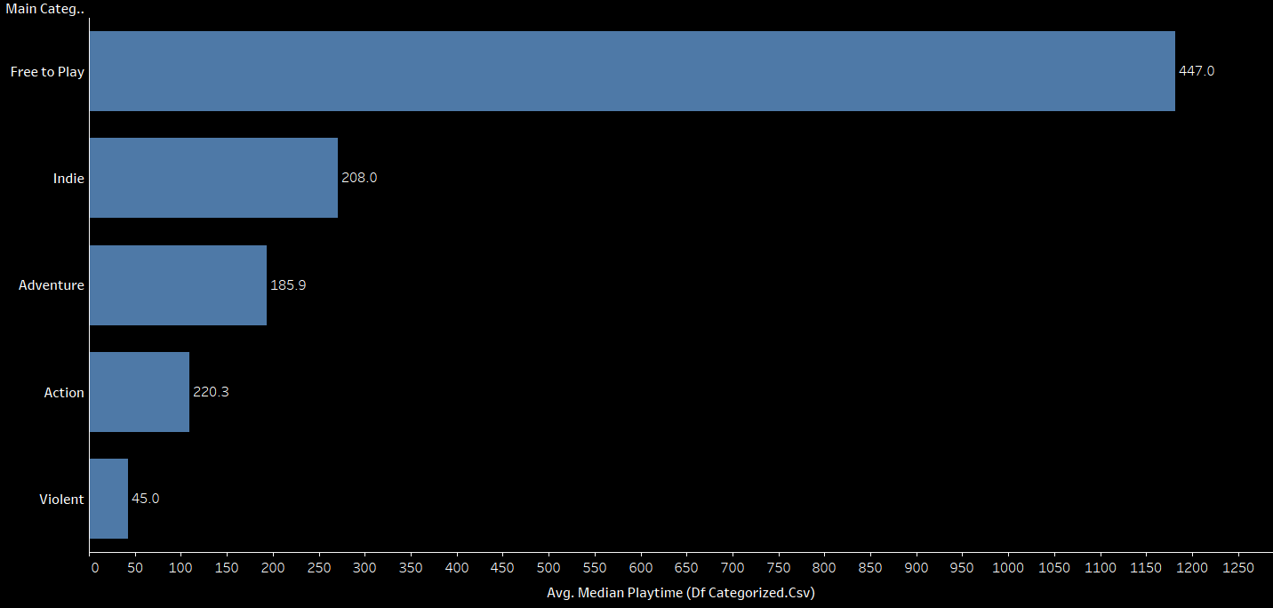
AVERAGE NUMBER OF GAMES PER GENRE
Notes:
The average number of games per genre is 17 games

Slide 16
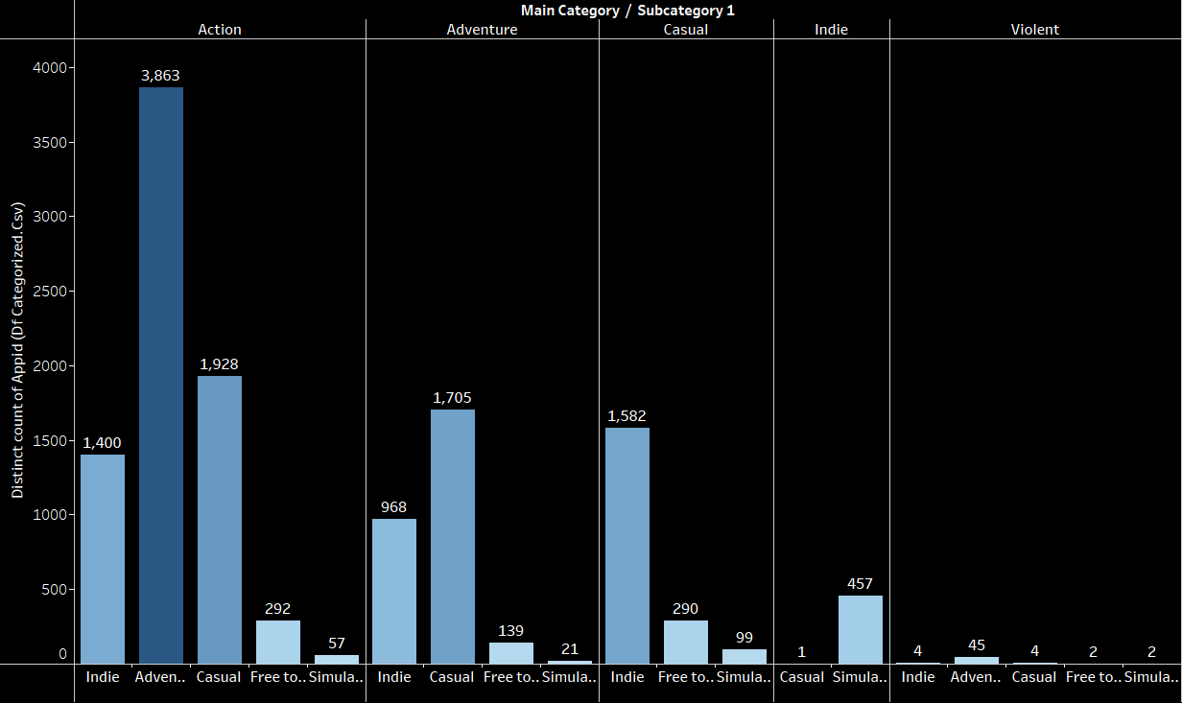
TOP SUBCATEGORIES IN TOP GENRES

Slide 17
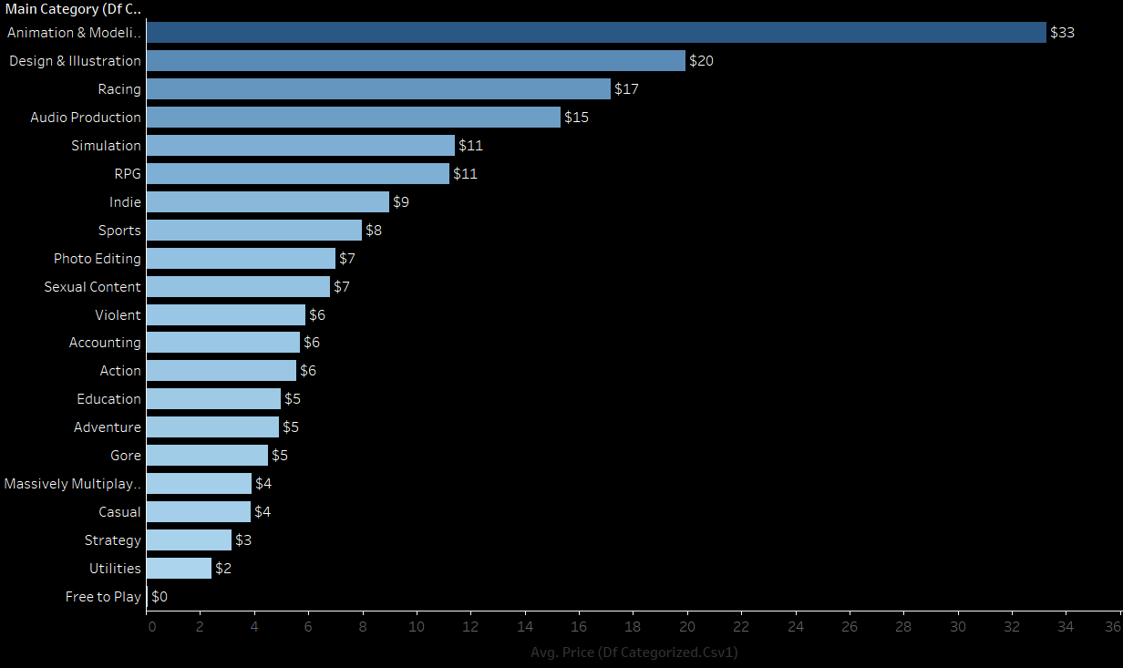
AVERAGE GAME PRICE PER CATEGORY

Slide 18
HIGHEST COUNT OF GAMES PER GENRE

Slide 19
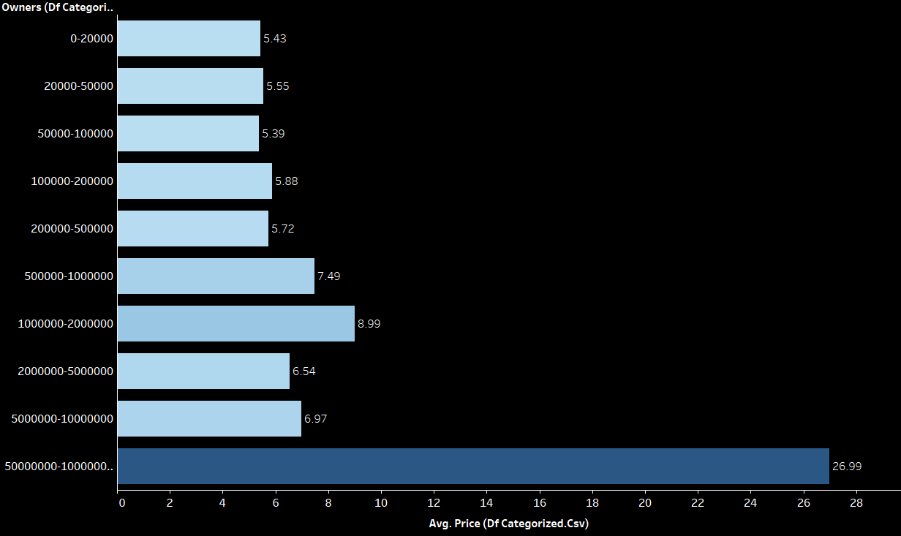
GAME PRICING PER THE NUMBER OF OWNERS
Notes:
Shows correlation between the number of owners and price
More owners reflect the success of the game

Slide 20
DEVELOPER ANALYSIS

Slide 21
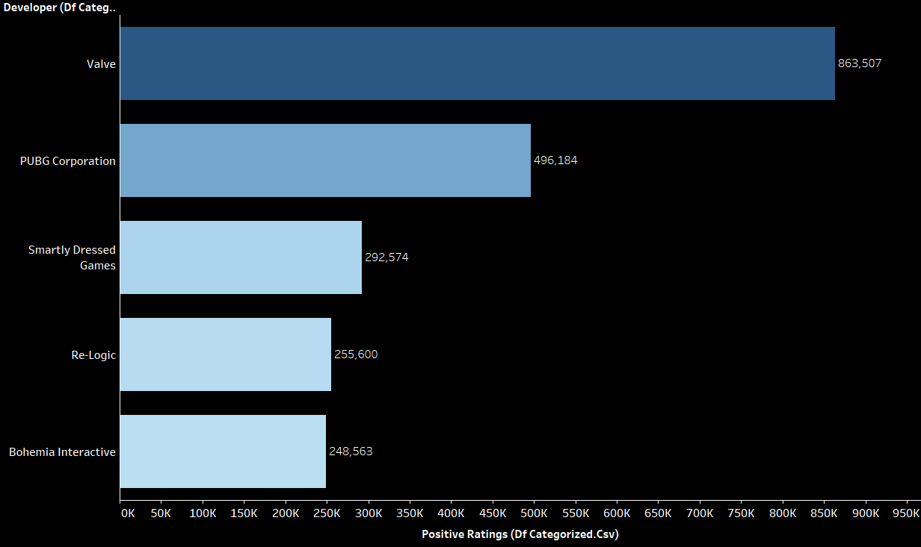
TOP RATED DEVELOPERS

Slide 22
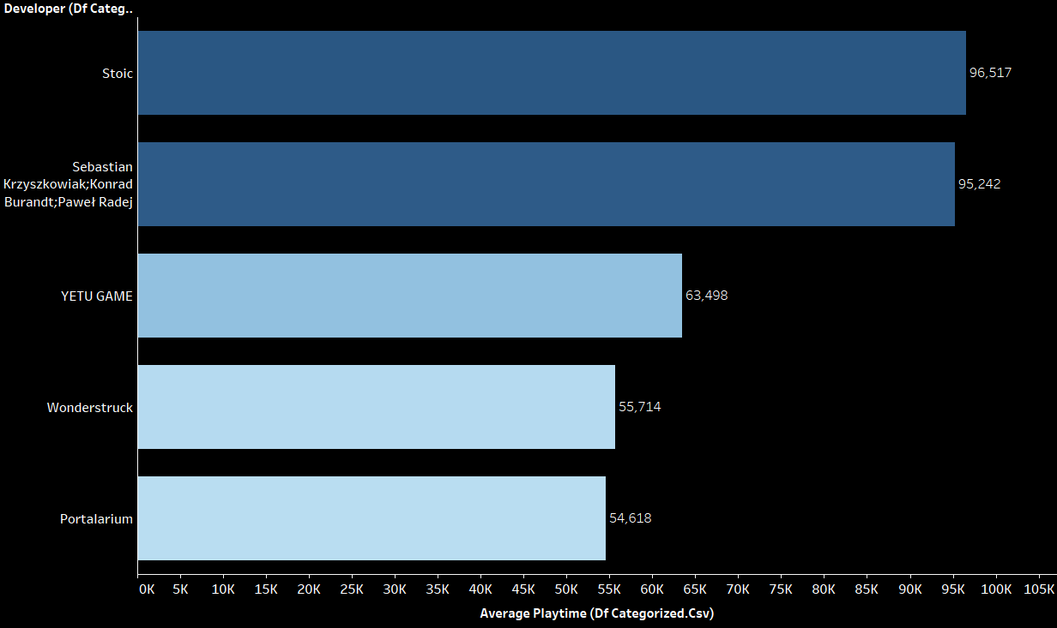
LONGEST PLAYED DEVELOPERS

Slide 23
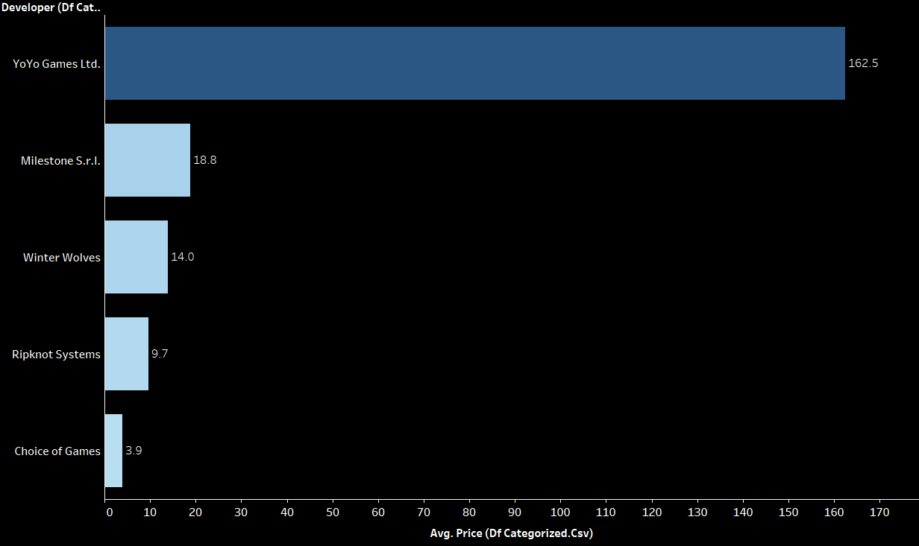
AVERAGE GAME PRICE PER DEVELOPER
Notes:
YoYO Games GameMaker is a complete development tool for making 2D games, used by indie developers, professional studios, and educators worldwide.

Slide 24
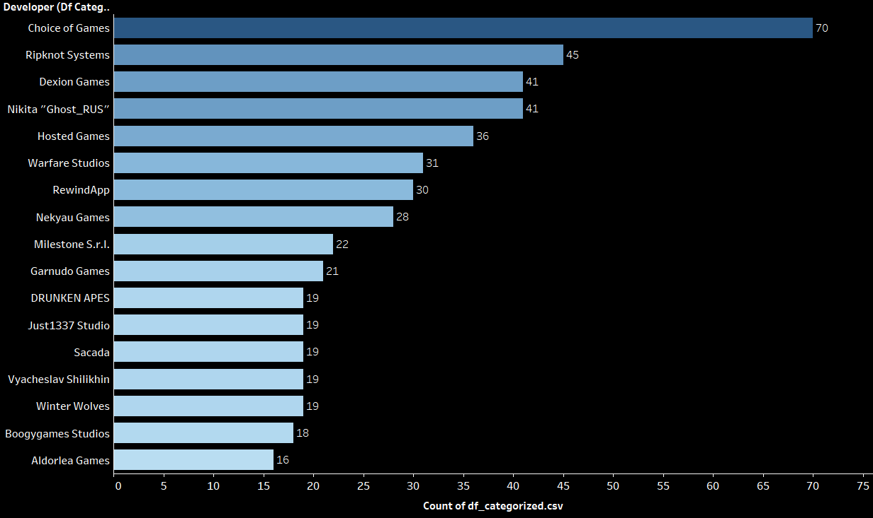
NUMBER OF YEARLY RELEASES BY DEVELOPERS
Notes:
Average number of releases for developers is 11 games per year
Choice of games was released and joined steam in 2014, releasing approx. 11 games per year

Slide 25
Recommendation
01
02
03
Data Quality
Genres
developers
Updated Data
Additional columns such as;
In-game purchases
Review criteria
Best performing genre: action
Best Performing Subcategory
Follow market price average for game pricing
Release a steady number of games yearly
Notes:
While the data had minimal nulls, more detailed information was lacking. Colomns such as detailed breakdown of in-game purchases, more details on positive reviews, as well as more recent data.
Games within the action genre preform better than others. Free games have the highest ratings and playtime, developers could make use of in-app purchases to make revenue. Data shows that players enjoy games in the action category.
Developers must focus on releasing a steady number of games yearly. Around 11 games. They must also focus on pricing their games around the average.

Slide 26
GAME OVER

